Slide 1
“Creating Standards for the 21st Century”
DSP Conference, Tyson’s VA
August 3rd, 2022
Jonathan Archer,
Director, Aerospace Standards Strategy & Innovation

Slide 2
Agenda
Who is SAE International?
Innovation and Aerospace Standards
Leveraging Digital Standards
Workforce Development

Slide 3
Who Is SAE International?

Slide 4
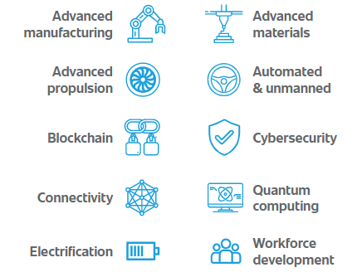
About SAE International
Vision
SAE is the leader in connecting and educating mobility professionals to enable safe, clean and accessible mobility solutions.
Ends
SAE International provides society and the global mobility engineering community with:
Neutral forums that convene to addresses society’s mobility needs
The most reliable and comprehensive collection of engineering resources that advance mobility
STEM education and professional development programs that inspire and build mobility’s current and future workforce
Consensus-based standards to advance quality, safety and innovation
A global community whose collective wisdom makes mobility safe, clean and accessible

Slide 5


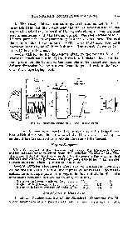

Our Community – SAE standards by the numbers
105
7,800+
Years of SAE aerospace standards
Active documents
11,000+
59
Participants
180
Countries
1,340+
17
Technical Committees
Works in Progress
New committees since 2017
4
Steering Groups

Slide 6
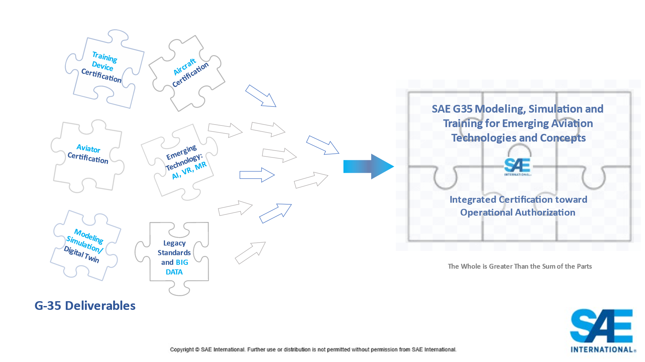
2021 – In Review
3,340 virtual meetings held
688 documents published
85 – brand new
New committees established:
AE-10 High Voltage
AE-11 Aging of High Energy Systems
G-35 Modelling, Simulation & Training
New committee structure – cohesion, synergy and integration

Slide 7
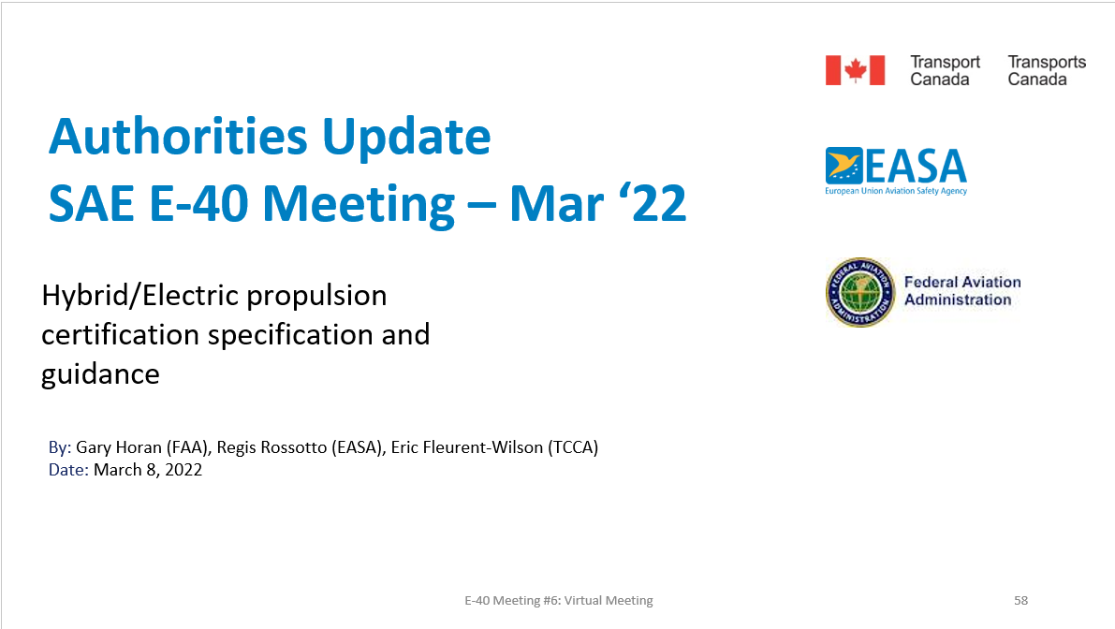
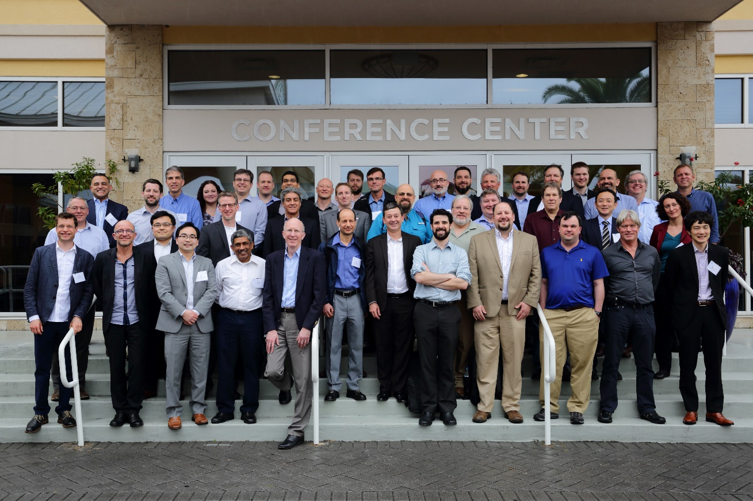
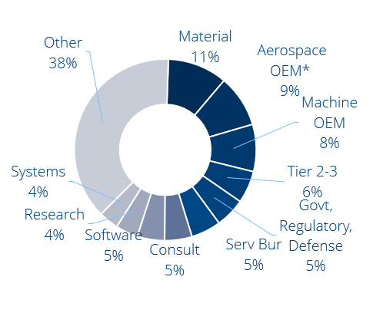
Convening & Facilitation
Bringing the best minds together
Globally, and across the eco-system
Industry + Government + Research
Networking, learning, leadership

Slide 8
Longstanding DoD/SAE Partnership
U.S. Standard B Liberty trucks built to SAE standards in World War I
1997 – Transfer of over 1500 MilSpecs to SAE during Mil-Spec Reform
DoD has adopted over 3400 SAE standards
  Largest number adopted of one standards developing organization
SAE is key player in DoD efforts to revitalize standardization in systems engineering
  Developed SAE EIA 649, Configuration Management (DoD adopted Mar 2015)
  Developed SAE AS6500, Manufacturing Management Program (DoD adopted Jan 2015)
SAE is key player in DoD efforts to prevent and detect counterfeit parts
  AS5553D Counterfeit Electrical, Electronic, and Electromechanical Parts Avoidance, Detection, Mitigation, and Disposition
  ARP6328 Guideline for Development of Counterfeit Electronic Parts Avoidance, Detection, Mitigation, and Disposition Systems
  DoD adopted

Slide 9


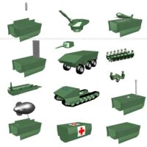

Global Defense Agency and Industry Participation In Standards Development
Leonardo
Airbus Defence & Space
Airbus Helicopters
BAE Systems
Boeing
Dassault Aviation
General Dynamics
GE Aviation
Lockheed Martin
MBDA
Meggitt
Northrup Grumman
Pratt & Whitney
QinetiQ
Rockwell Collins
Rolls Royce
Saab Aircraft
Safran
Sikorsky
Thales
U.S. Department of Defense
U.S. Air Force
US Army
US Army RDECOM
US army TARDEC
U.S. Navy (NAVAIR, NAVSEA)
Defense Contracts Management Agency (USA)
Defense Logistics Agency (USA)
Canadian Department of National Defense
Canadian Air Force
UK Ministry of Defence
Royal Air Force
Military Aviation Authority
French Ministry of Defence
DGA (France)
NATO – NSA
Department of Defense
HBM-nCode
iRobot
TU Darmstadt
Andromeda Systems Incorporated
Nevada Automotive Test Center
General Dynamics Land Systems
GP Technologies Inc
Aberdeen Test Center
DRS Sustainment Systems

Slide 10
Innovation and Aerospace Standards

Slide 11
Systems Safety
Trusted processes, applied to revolutionary aviation concepts
S-18: Development processes which support certification of novel aircraft systems
ARP4754B and ARP4761A coming soon
Scalable use of safety processes for new vehicle designs and unmanned systems – AIR7209 & AIR7121
*New committee* S-18H incorporating human factors into the safety process

Slide 12
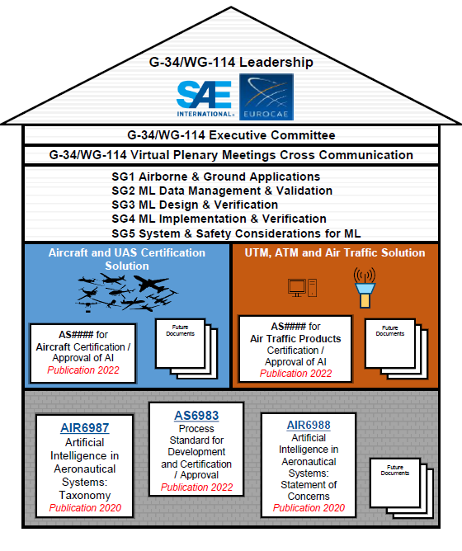
Enabling Autonomy
Artificial Intelligence & Machine Learning
First aviation AI document AIR6988 published 2021
Taxonomy: speaking the same language – AIR6987, planned for 2022
Process standard supporting certification of AI – AS6983
Predictive Maintenance use cases

Slide 13

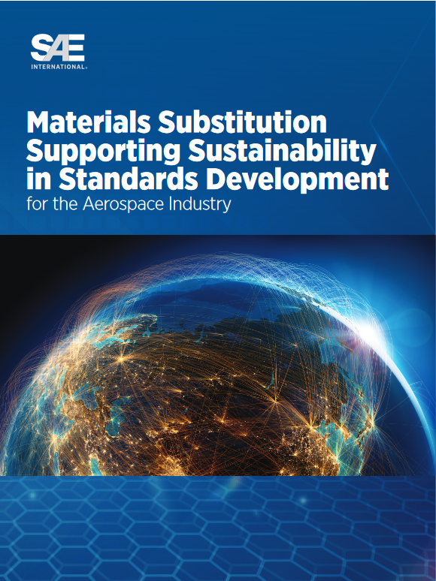
Enabling sustainable flight
Hydrogen: 3 documents published. New project AS7373 Gaseous Hydrogen storage for General Aviation & AAM
Storage, handling, aircraft system management of SAF
Materials substitution & replacement technologies
Electrification…

Slide 14
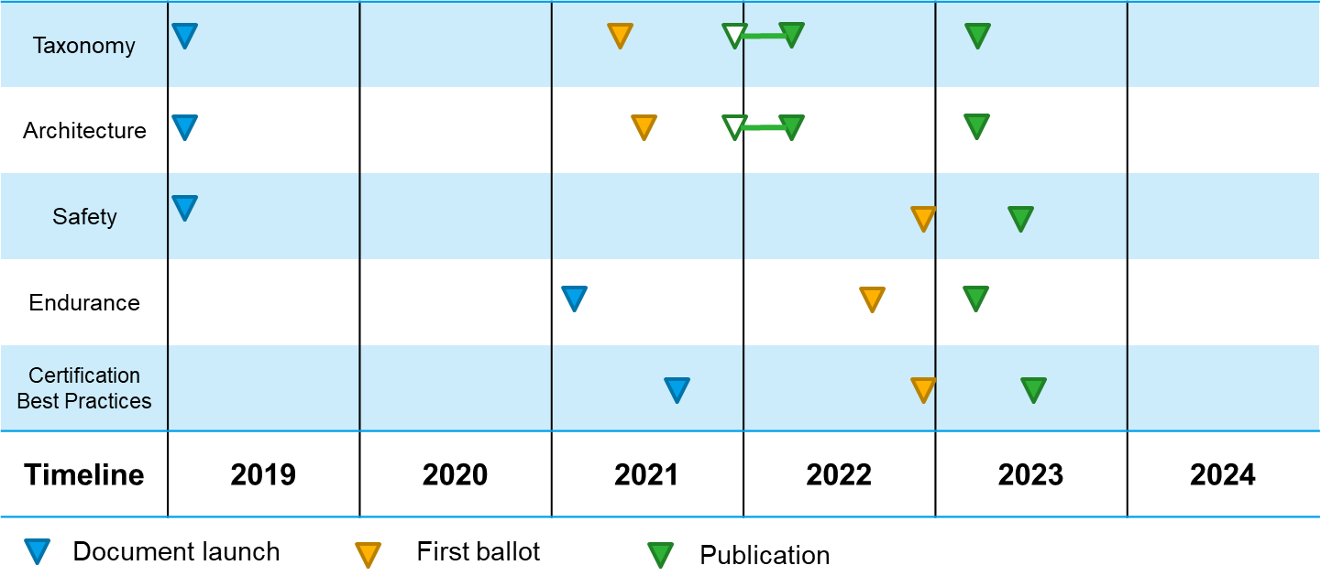
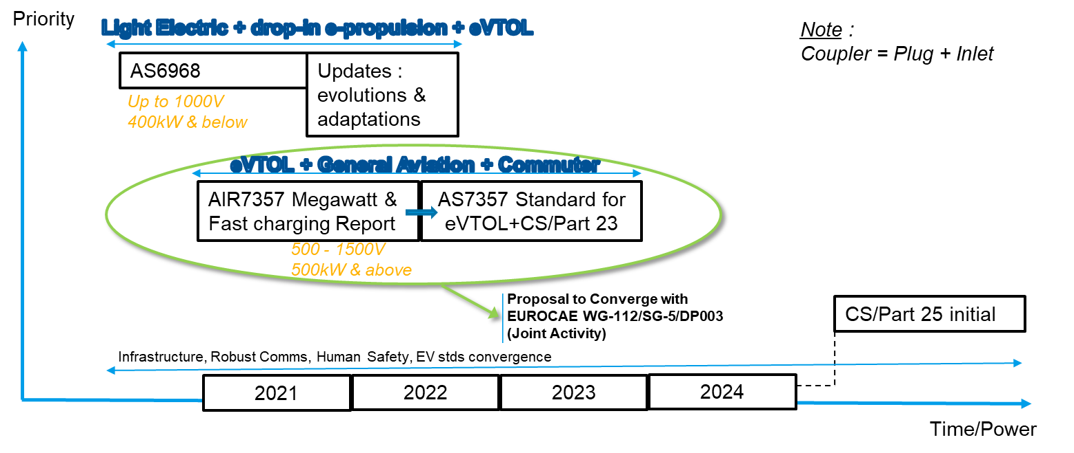
Enabling electrified propulsion, power & infrastructure
E-40 Electrified Propulsion: Taxonomy, Architecture, Safety, Endurance Testing ARP8689
AE-10 High Voltage – High Voltage Levels published, Power Quality coming soon
AE-7D Megawatt & Fast Charging AS7357
AS6968 for light electric aircraft

Slide 15
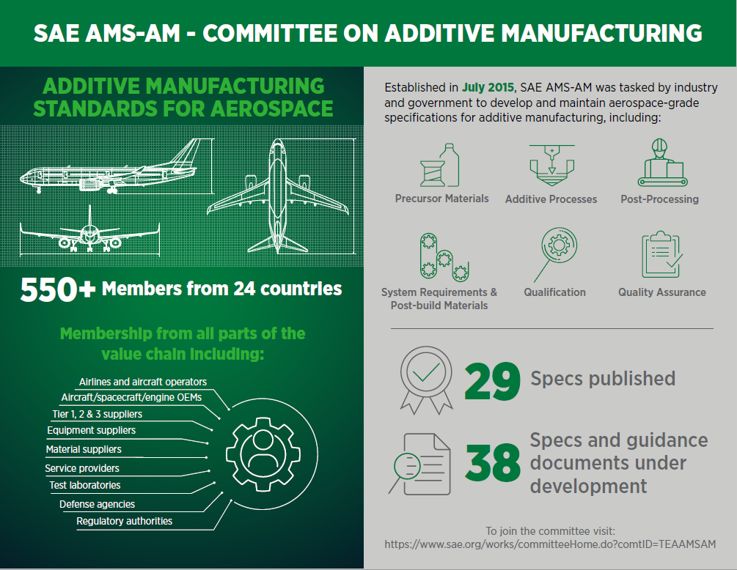
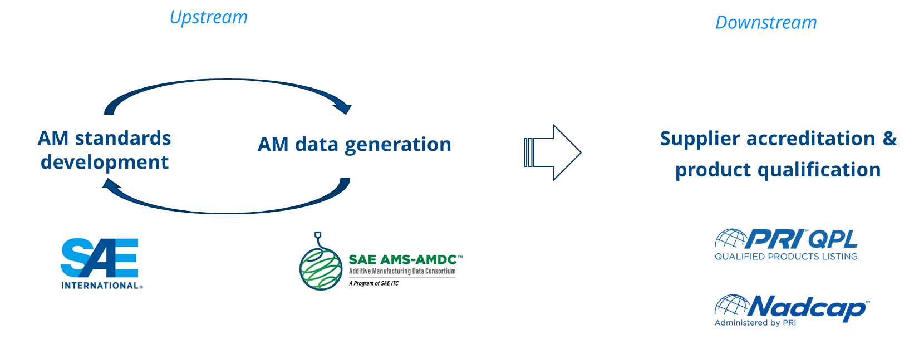
The Additive Paradigm
Material, Process, Qualification
25+ M+P Specs published
Process control – AMS7003 (Rev A coming in May)
Recycling – AMS7031
Repeatability through machine qualification – AMS7032 (final draft)
SAE Group value

Slide 16
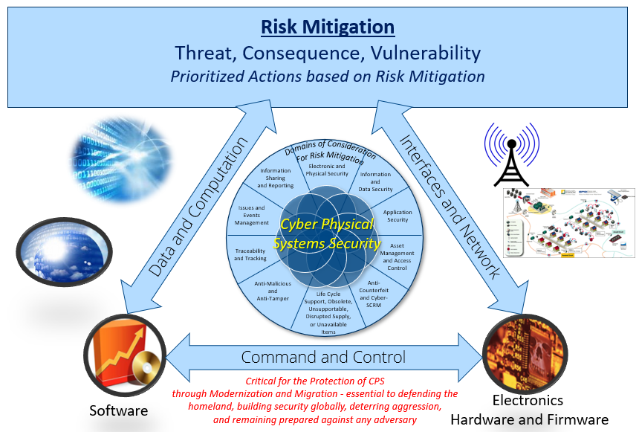
Protection through cybersecurity
Enabling multiple industries to identify – and mitigate – vulnerabilities throughout the supply chain and product lifecyle.
Systems engineering approach to cyber-physical security integrating with anti-counterfeit and quality standards
JA7496 CPSSEP – Publishing in May 2022 (HW/SW to follow…)

Slide 17

Digital Transformation
SAE’s Digital & Data Steering Group & G-31 committee:
Overviews of Electronic Transactions (ARP6823) & Digital Data standards (AIR7501) published
Now…
Digitizing the release process: AIR7123 eARC
Introducing blockchain for aviation AIR7356
Digital thread AIR7367
The role of MBSE in manufacturing and certification

Slide 18
Leveraging Digital Standards

Slide 19
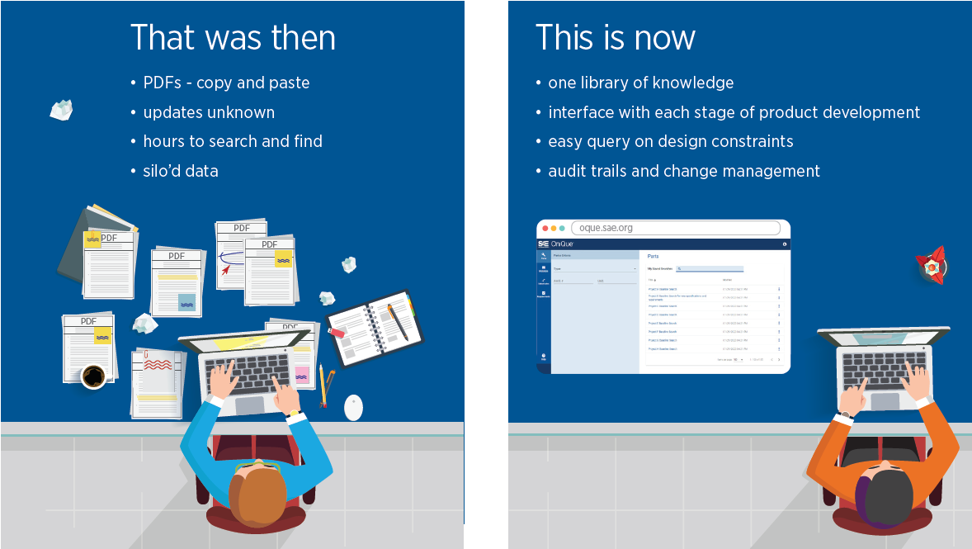

Standards Access – Then and Now
Copyright © SAE International. Further use is not permitted without permission from SAE

Slide 20
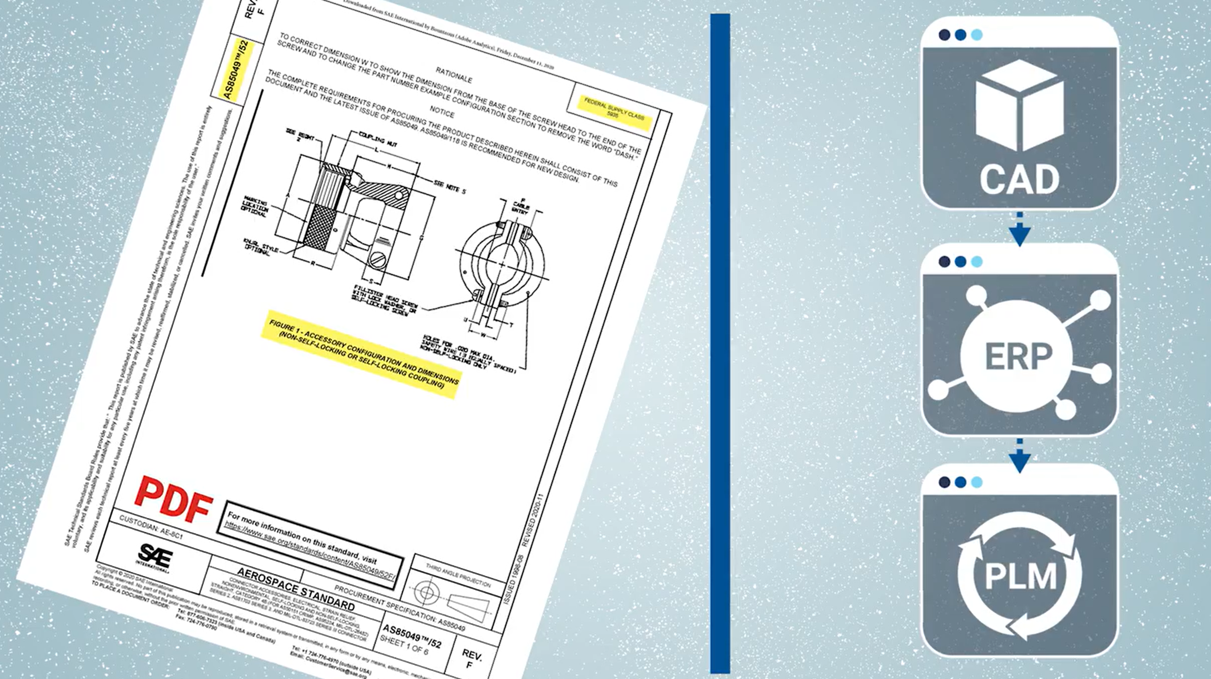

Digital Product Development Solutions Need Digital Requirements, Not PDFs
MBSE
MBSE
REQ
Copyright © SAE International. Further use is not permitted without permission from SAE

Slide 21



How many references do you have to maintain for your product designs?
SAE
ASTM
ASME
MIL
Internal Specs
Requirements
Copyright © SAE International. Further use is not permitted without permission from SAE

Slide 22
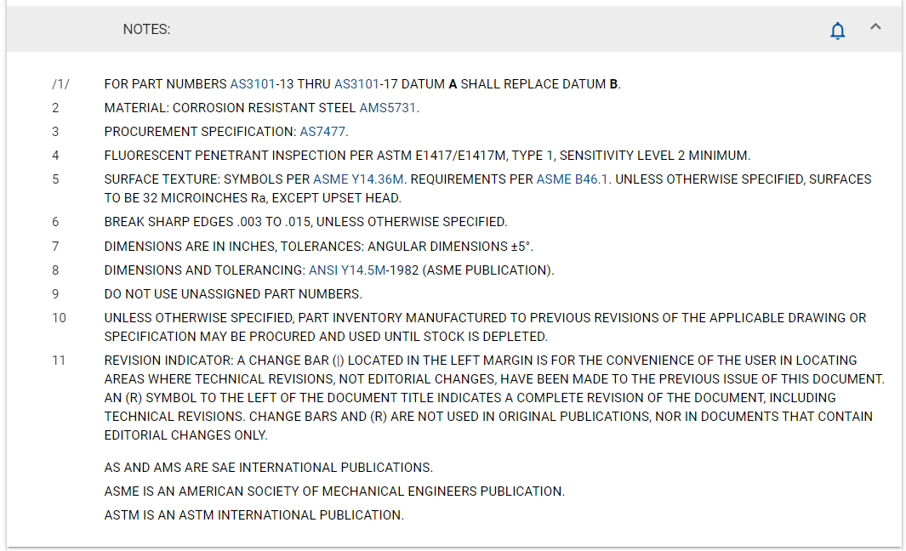
Extended Interoperability
Flag sections/ requirements for change notifications
Link to related references
Maintain context
Copyright © SAE International. Further use is not permitted without permission from SAE

Slide 23
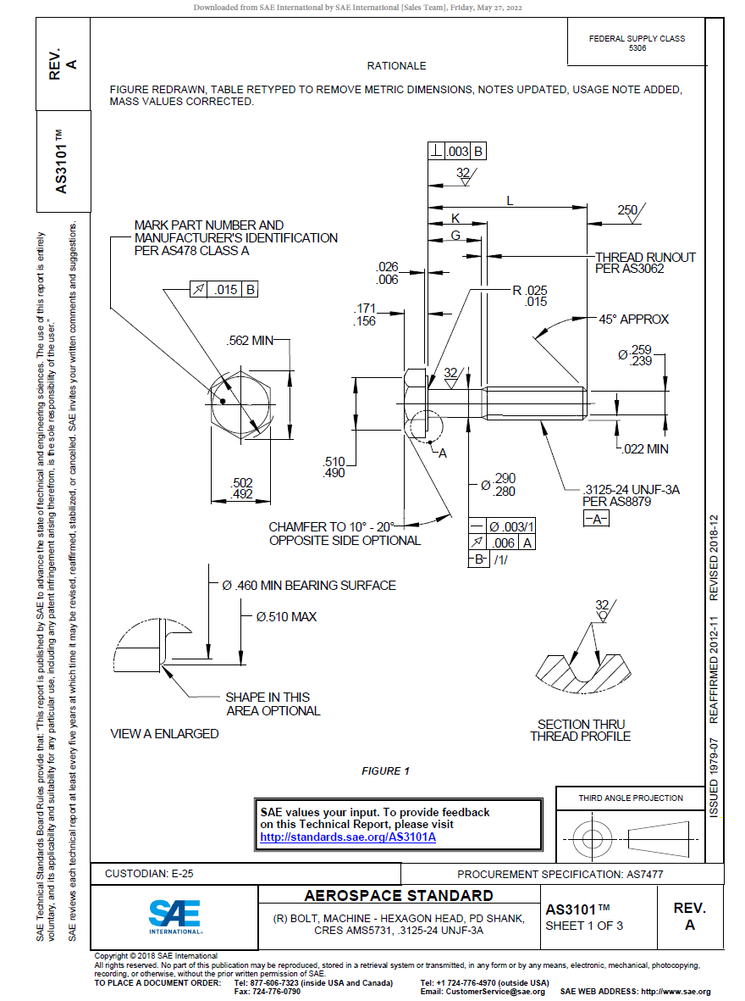
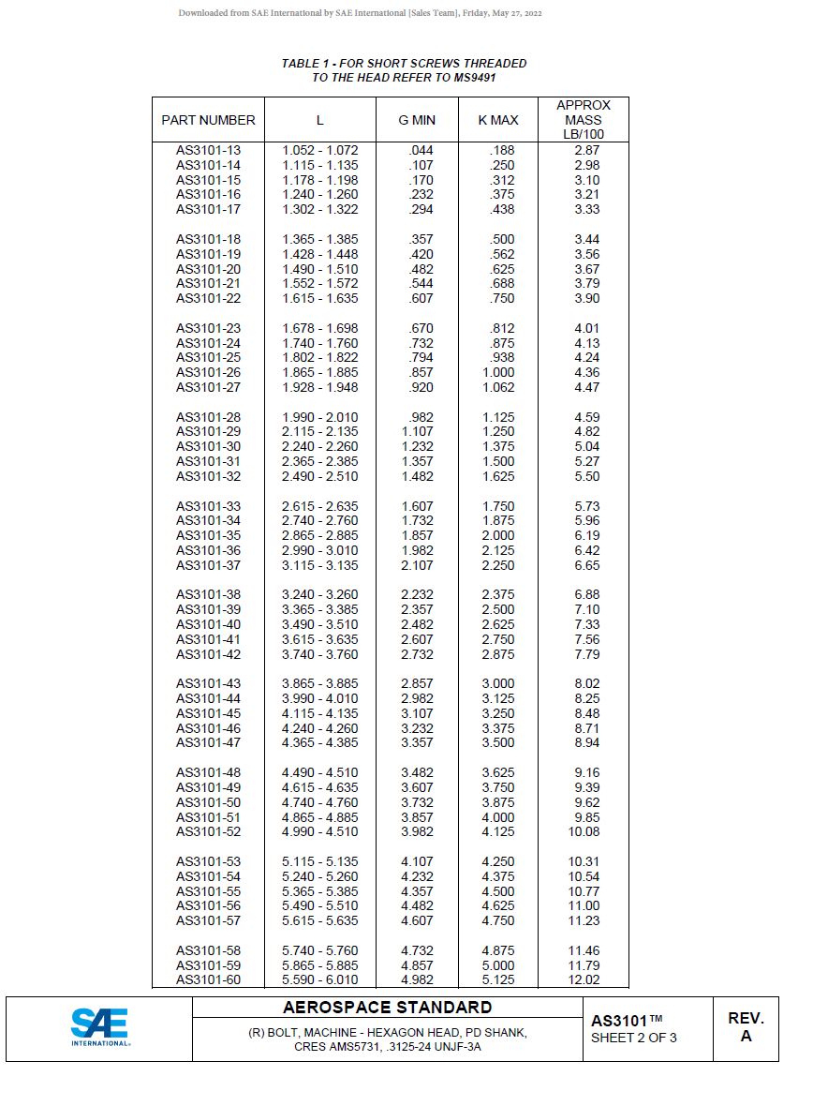
Leveraging Requirements from Digital Standards
Drawings and Tables Converted to Machine-Readable Data
Min/Max requirement for Length can be tracked in Requirements Tracking Tool
Min/Max requirement for Length can be part of simulation
Min/Max requirement may be in digital twin
Min/Max requirement can be used in test cases
Min/Max requirement can be fed into procurement applications
Min/Max requirement used to establish compliance
And so on…
(R) BOLT, MACHINE - HEXAGON HEAD, PD SHANK, CRES AMS5731, .3125-24 UNJF-3A
Part Number | Standard | AMS | Type | L (inch) min | L (inch) max
AS3101-13 | AS3101A | AMS5731 | Bolt | 1.052 | 1.072

Slide 24
ROI Considerations
Eliminate copy/paste from PDFs
~10 hours
Eliminate re-entry of requirements
into multiple systems
~5 hours
Reduce time searching for relevant standards
~2 hours
Eliminate rework due to data entry errors
~4 weeks
Reduce number of physical prototypes
~20 hours + cost savings by cutting 6 prototypes ($1,000 avg each)
Minimize source documents for audits (digital thread)
~40 hours
~$20,000 in time + cost savings per project
Notes:
Use $60/hour rate

Slide 25

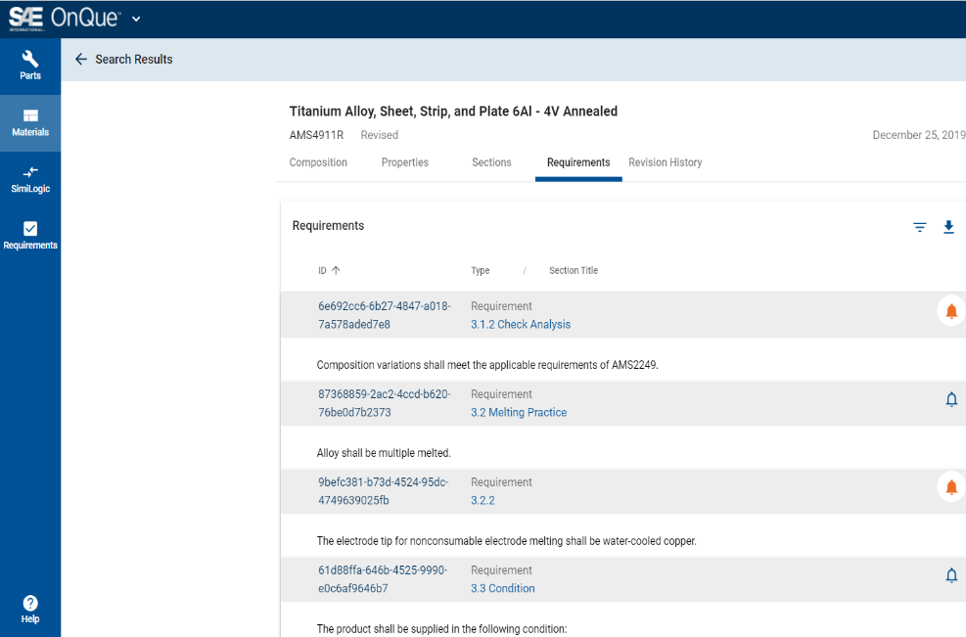
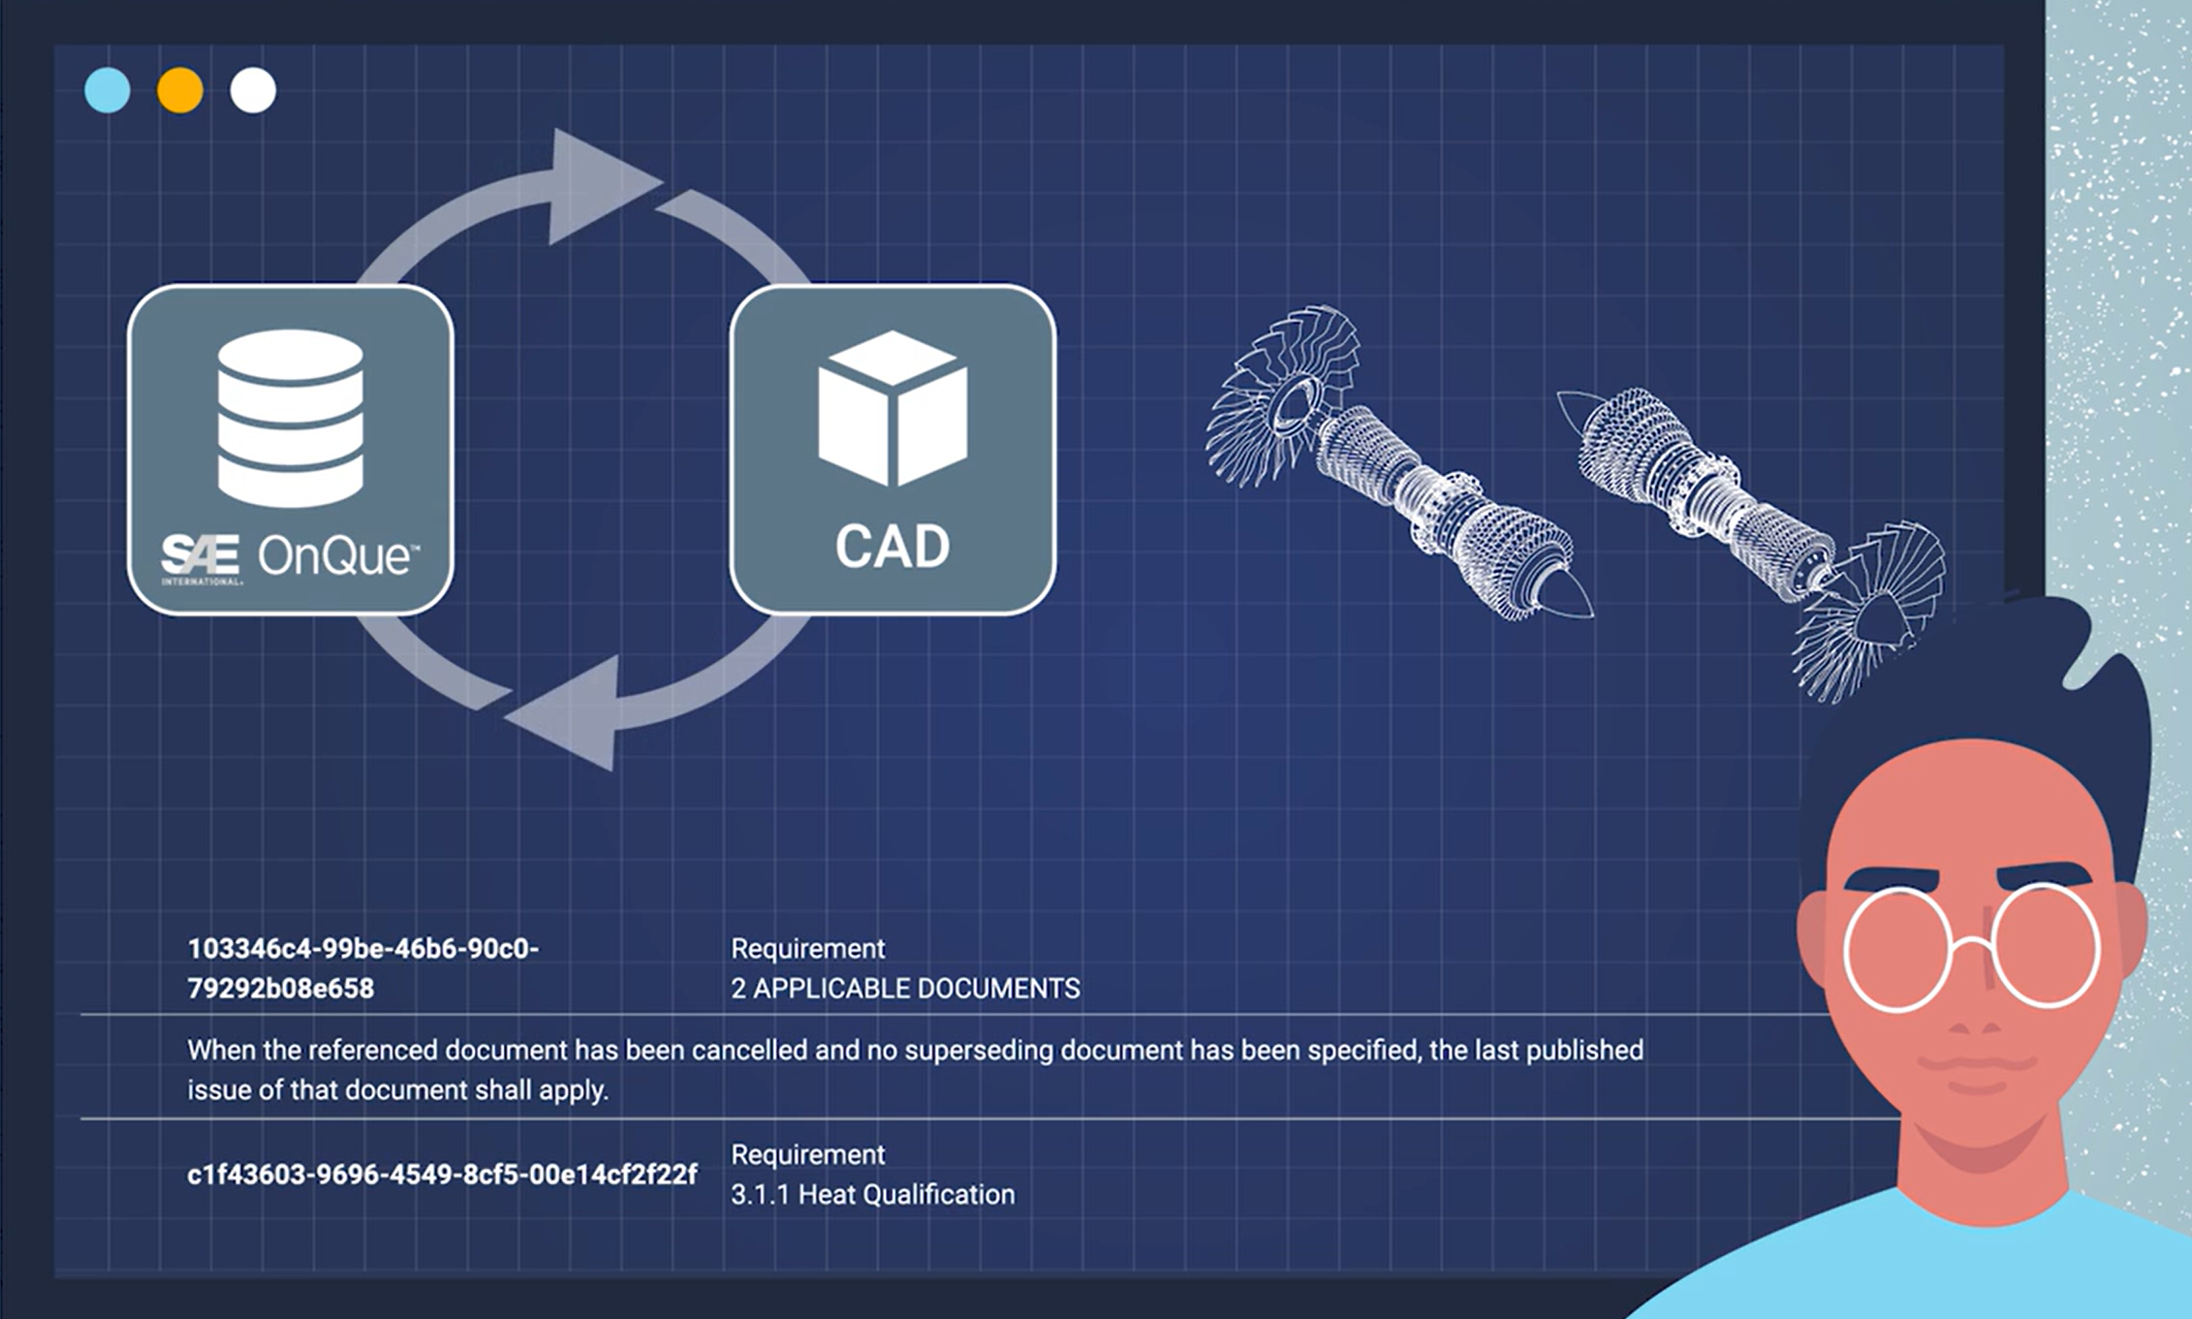





Digital Standards

Slide 26
Workforce Development

Slide 27




Workforce Development – Lifelong Learning
A World in Motion
SAE Aero Design (West)
SAE AeroConnect
Professional Development

Slide 28
QUESTIONS?
Jonathan Archer
Director, Aerospace Standards, Strategy & Innovation
Washington, DC
Jonathan.Archer@sae.org | +1 724 355 6404

